Slide 1

Predict Student Dropouts
Dave Widjaja
Joseph Mcclain
JP Millan
Keerthanaa Ellur
Khue Nguyen
Temi Oyefeso
Vince Luong

Slide 2
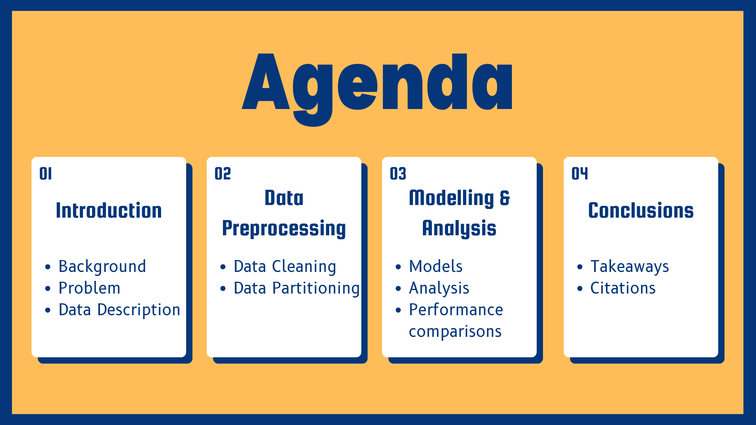
Agenda
I. Intro
Background
Problem
Data description
II. Data Preprocessing
Data Cleaning
Data Partitioning
III. Modelling and Analysis
Models and Analysis
Performance Comparisons
IV. Conclusion
Takeaways
Citations

Slide 3


Intro

Slide 4
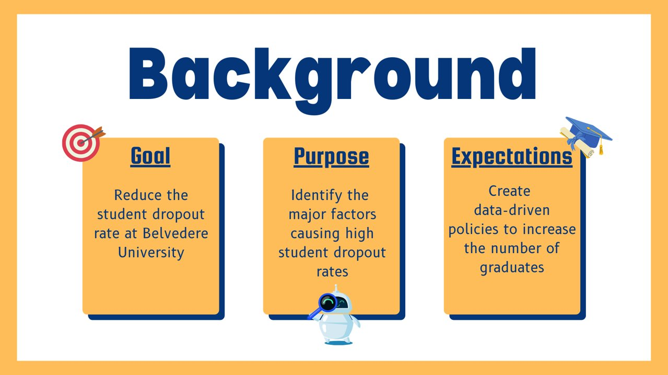
Background

Slide 5

Problem

Slide 6

Dataset Origin:
UCI Machine Learning Repository
https://archive.ics.uci.edu/dataset/697/predict+students+dropout+and+academic+success
Scope of Data:
Focuses on student demographics, academic performance, and socio-economic context.
Includes factors such as grades, parental education, and national economic indicators.
Target Variable:
Predicts outcomes: Dropout, Graduate, or Enrolled.
Sample Features:
Categorical: Marital Status, Course, Nationality, Educational Needs.
Continuous: Admission Grade, Previous Qualification Grade, GDP, Unemployment Rate.

Slide 7

Descriptive Statistics of Demographics

Slide 8
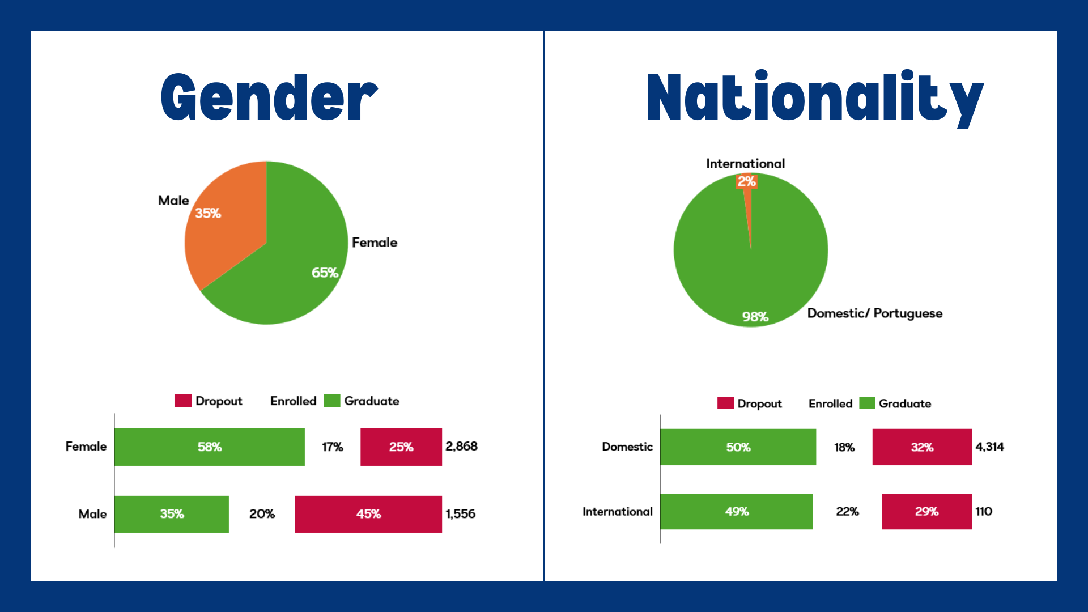

Slide 9
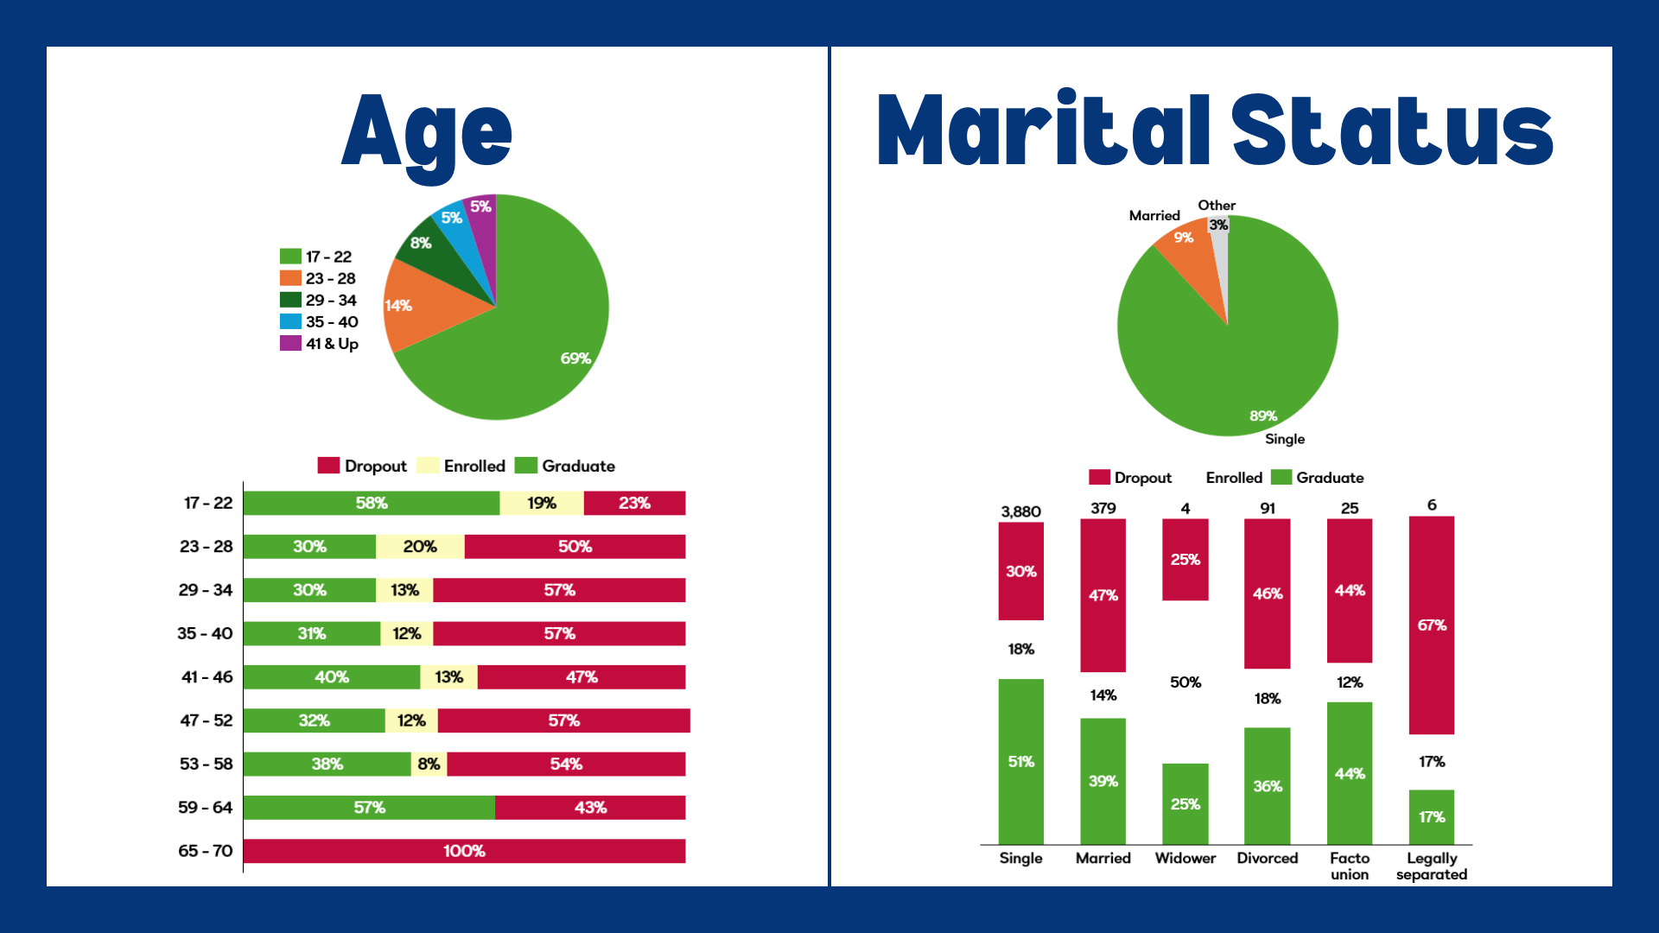

Slide 10

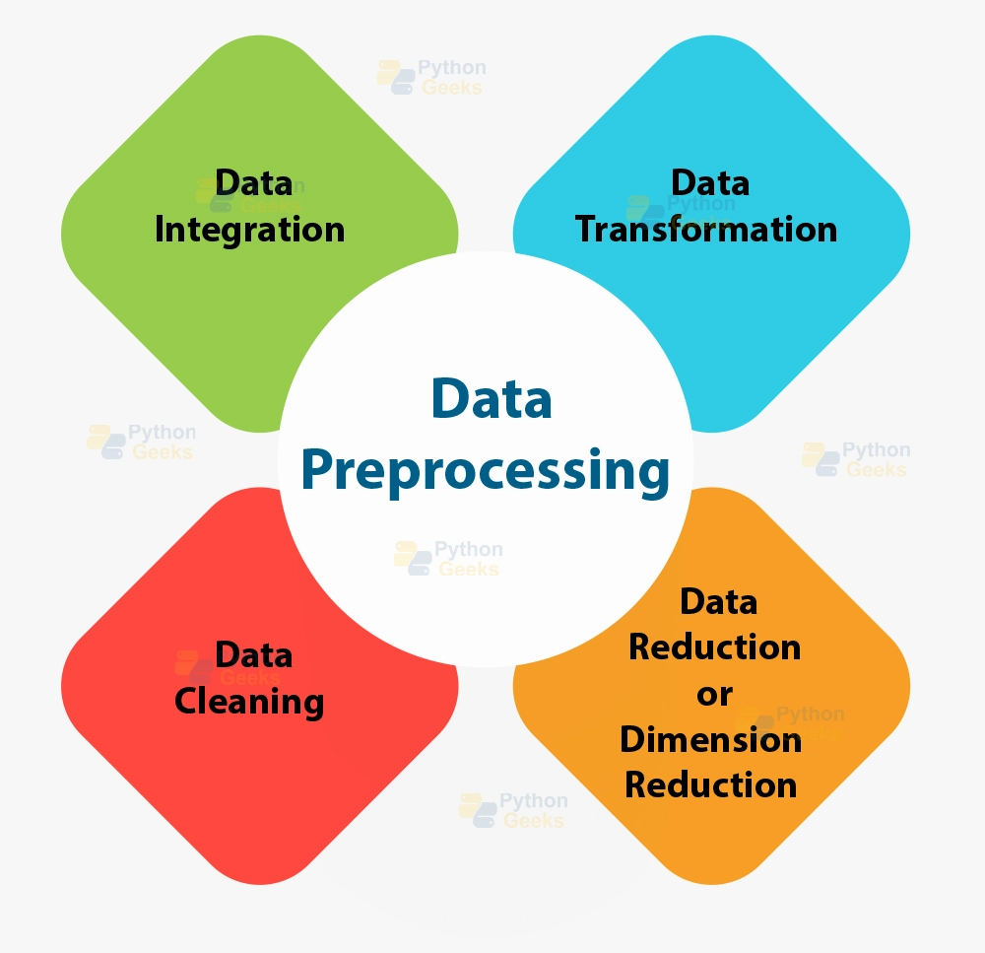
Data Preprocessing

Slide 11

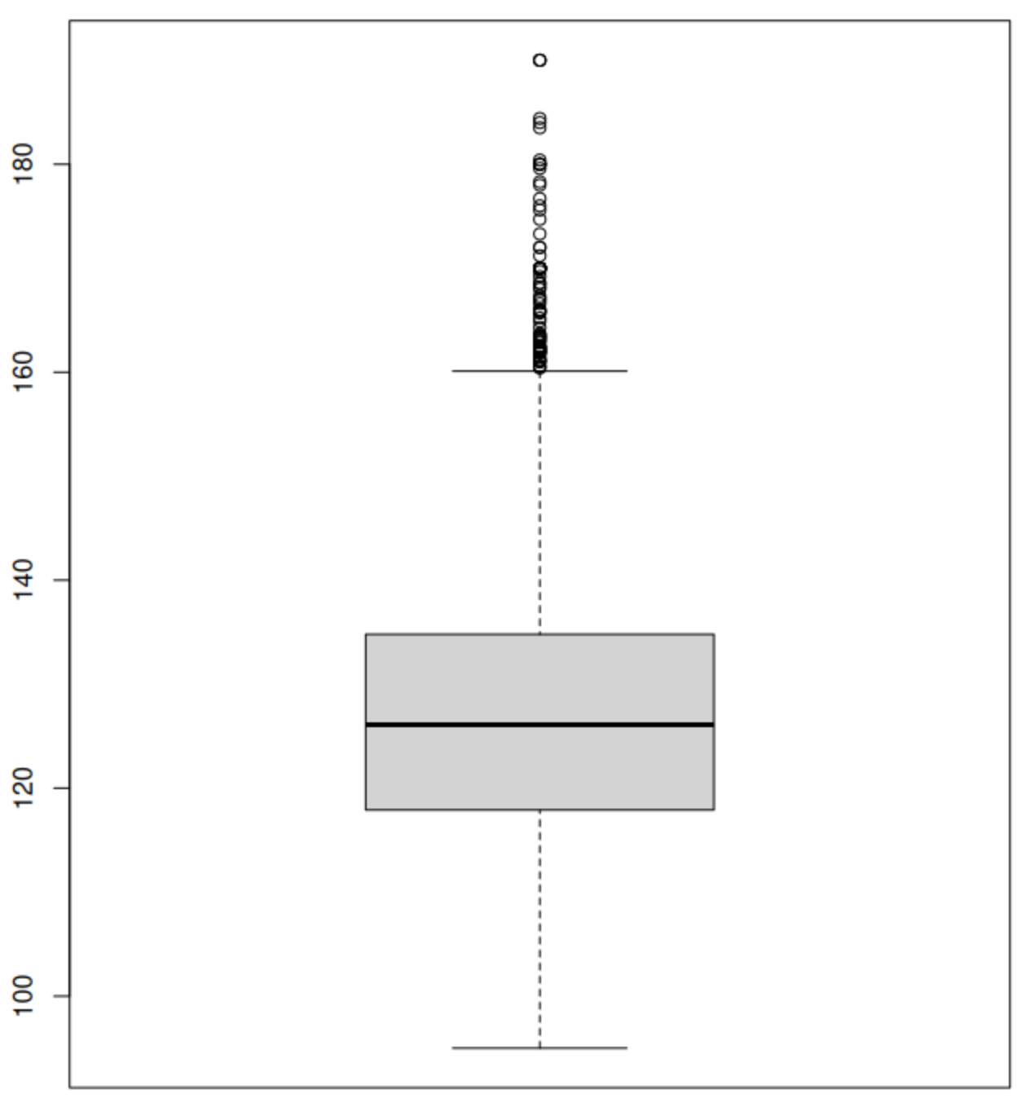
Dataset Summary:
Rows: 4424, Columns: 37
No missing values.
Steps Taken:
Checked distributions of continuous variables.
Removed outliers and highly correlated variables
Recoded categorical variables (e.g., Marital Status, Nationality).
Admission Grade Box Plot

Slide 12

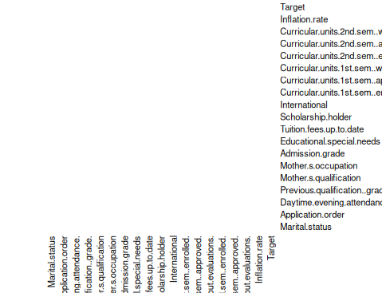

Slide 13
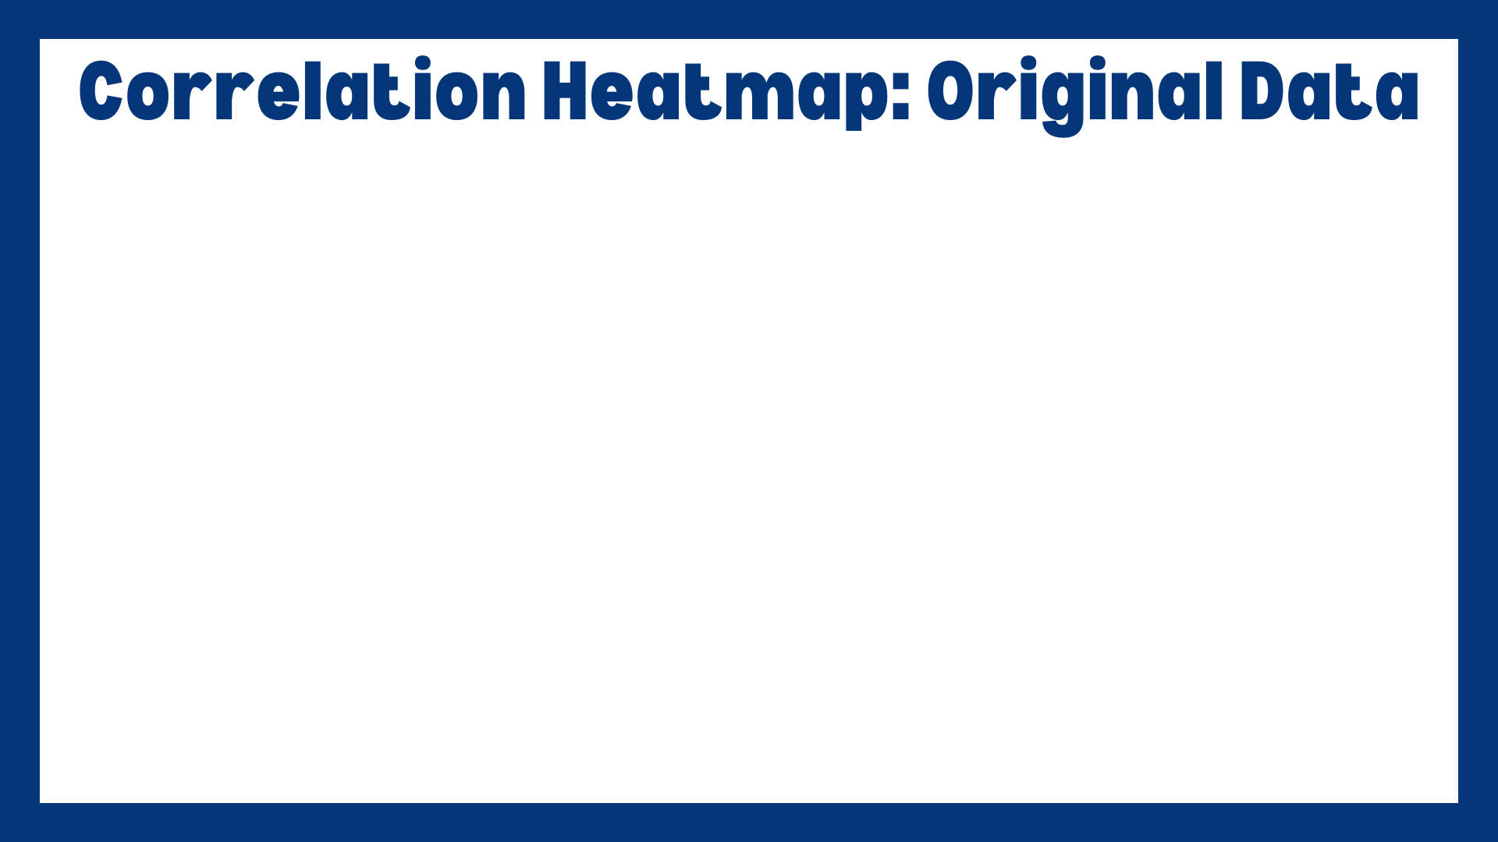
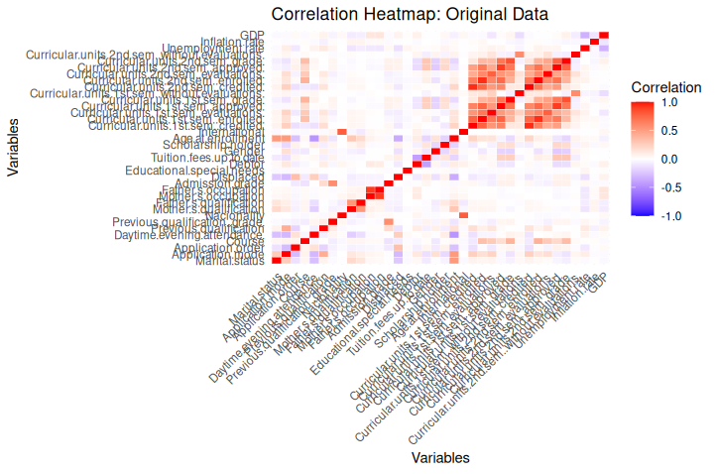

Slide 14

Categorical Variables:
Grouped and labeled variables (e.g., Courses, Application Mode).
Converted categorical predictors into dummy variables.
Continuous Variables:
Standardized and grouped into meaningful ranges (e.g., Grades, Age).
Optimization:
Removed low-variance and highly correlated variables.
Removed outliers

Slide 15

Columns: 85 after preprocessing.
Rows: 4338 after removing outliers
Retained only significant predictors by removing:
Low-variance variables.
Highly correlated variables (correlation > 0.9).
Dummy variables created for categorical features to prepare for analysis.
Optimization Goals:
Ensure data is free from redundancies.
Improve model interpretability and efficiency.
Further optimization (as needed) when exploring models

Slide 16
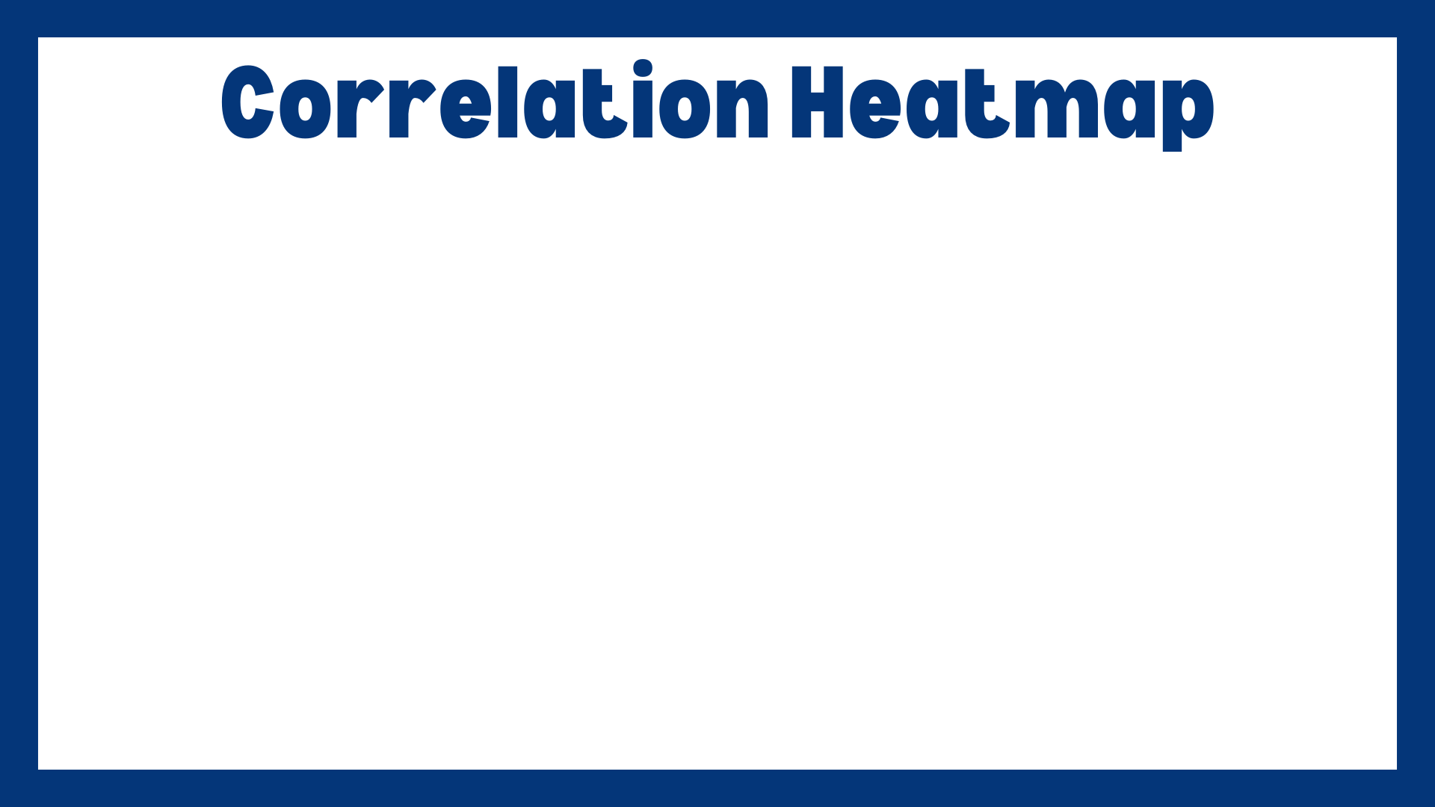
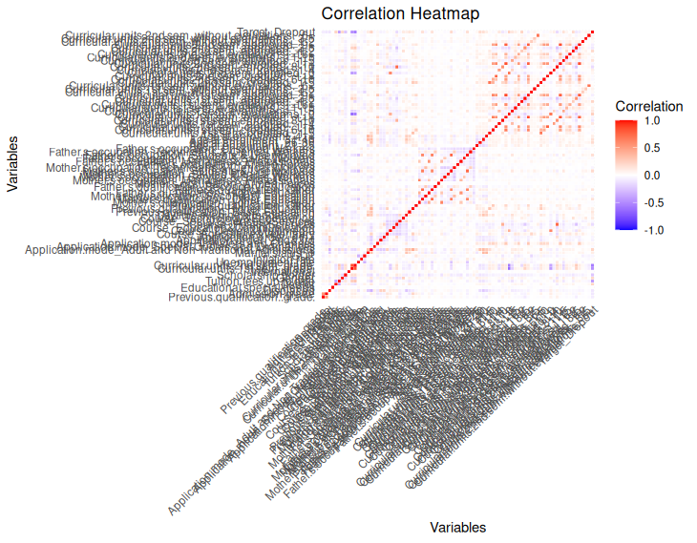

Slide 17

Modeling and Analysis
Enhancing your presentation

Slide 18
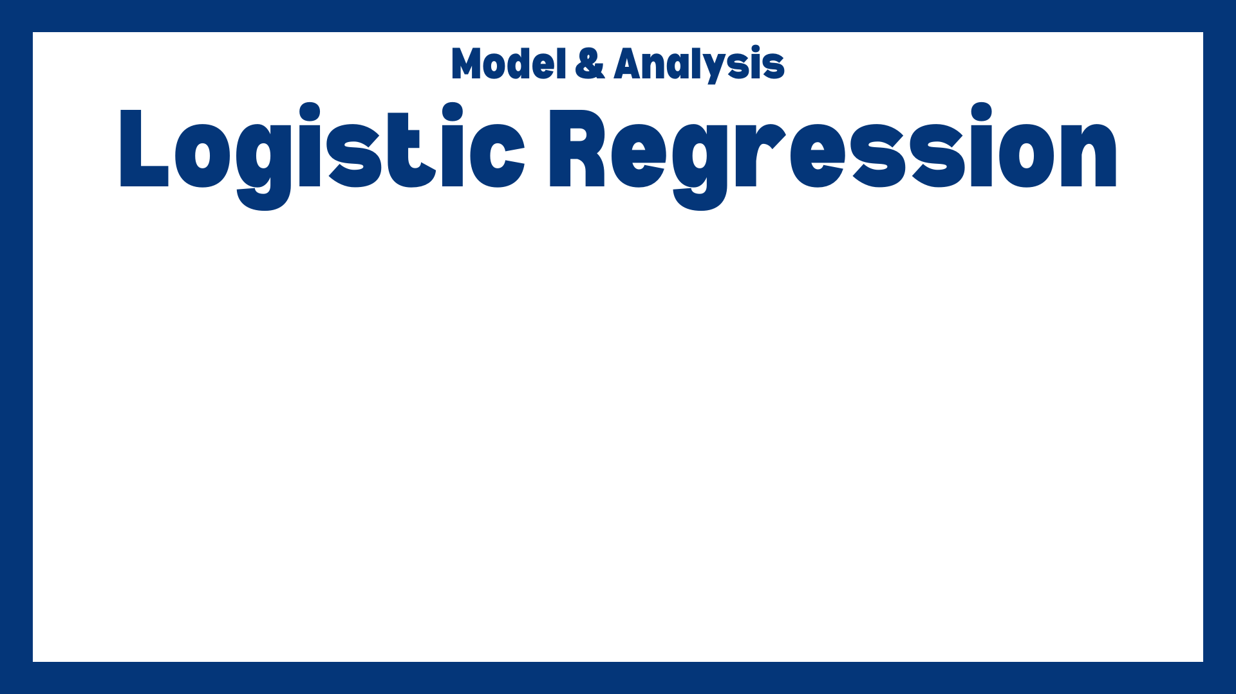
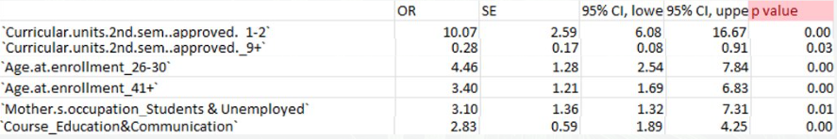
Total 48 variables, 35 significant and 13 insignificant

Slide 19
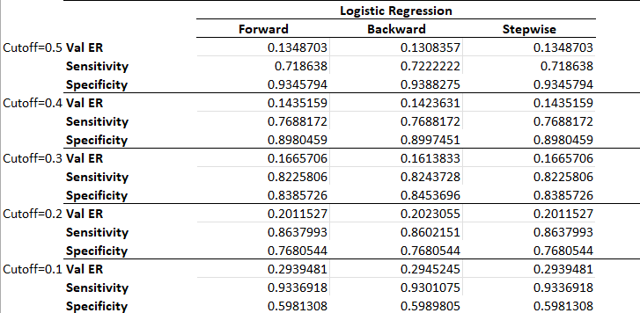
At higher cutoff values (0.4, 0.5): correctly identify students who will not drop out (true negatives)
At lower cutoff values (0.1, 0.2, 0.3): correctly identify students who will drop out (true positives)
Accuracy also decreases

Slide 20
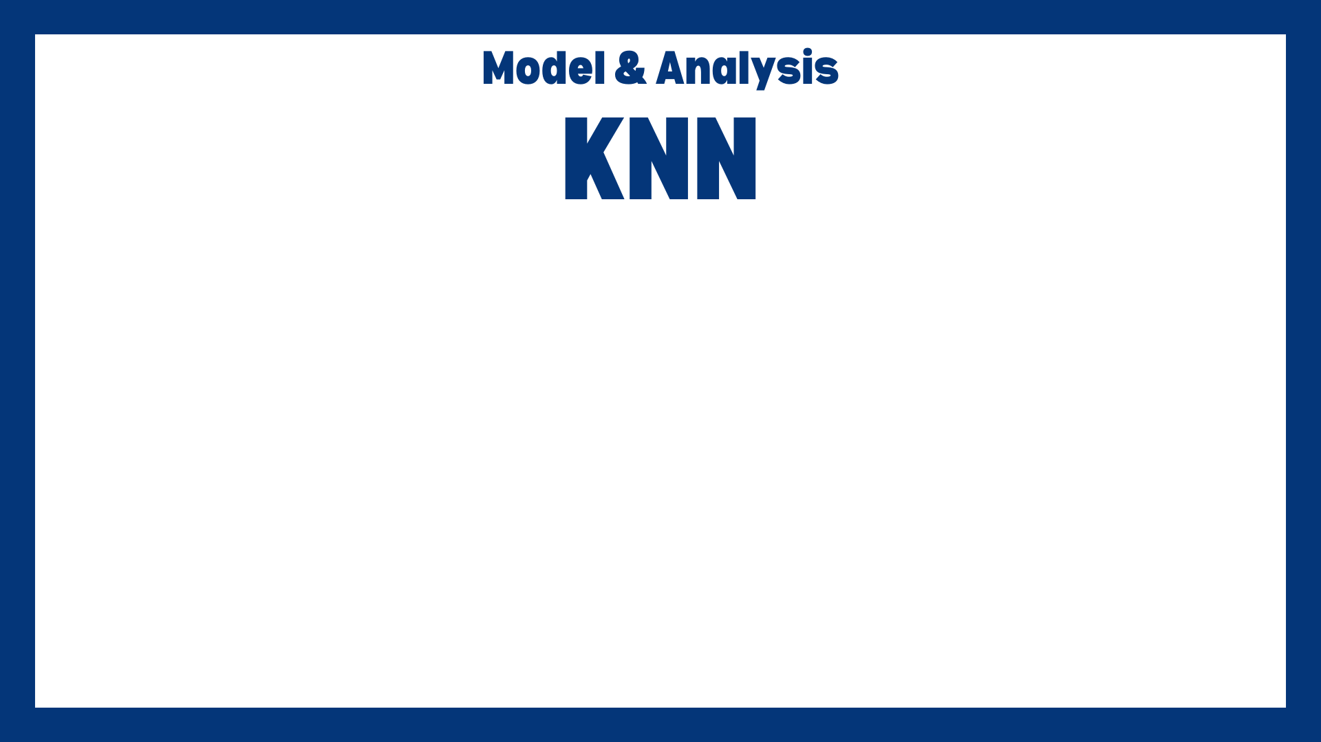
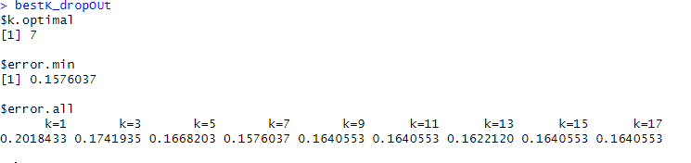
Variable used: all variables from cleaned data
Best K chosen from k with lowest error rate on validation data

Slide 21
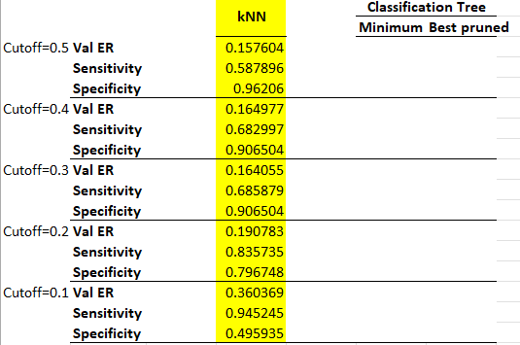
Lower cutoffs – higher sensitivity:
correctly identify students who will drop out (true positives)
Higher cutoffs – higher specifity:
correctly identify students who will not drop out (true negatives)
For student dropout prediction, it is generally more important to have higher sensitivity because preventing Dropouts is the priority => choose cutoff 0.1

Slide 22
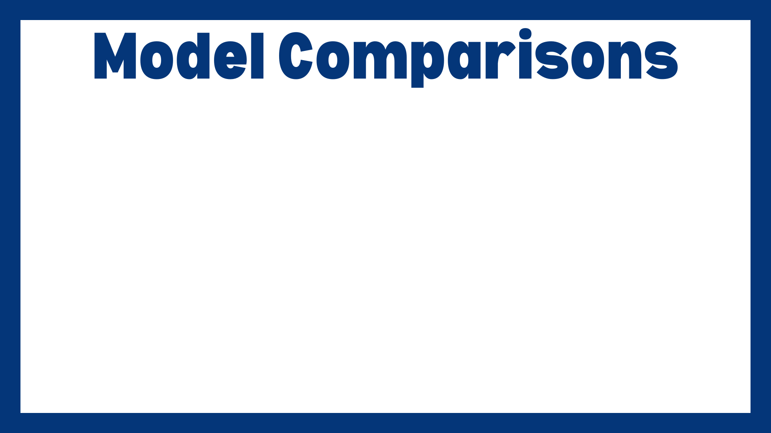
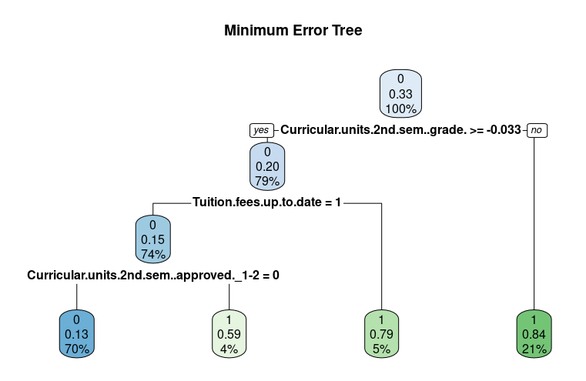
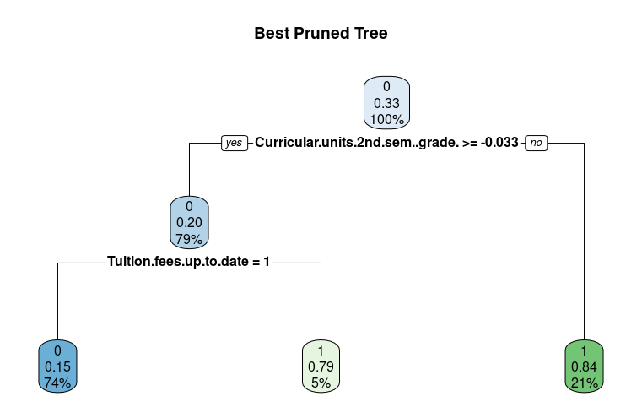
Best Pruned Tree sacrifices granularity to preserve flexibility of model by giving less precedence to insignificant variables resulting in less nodes.
Minimum Error Tree has more splitting because it gives precedence to all variable data but can lead to overfitting.

Slide 23

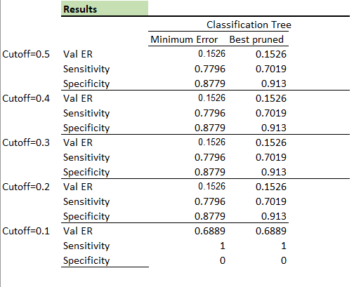
Our CART models provided a lower sensitivity rate but a higher specificity rate indicating more success at identifying negative cases
Having different cut off levels did not have significant impact on metrics
Based on our desire to identify students more likely to drop out using BPT is better model because it responds better to new data

Slide 24


Slide 25

Predicting student dropouts using classification methods (such as logistic regression, kNN classifications, and decision trees) can offer valuable insights into the factors contributing to student dropout:
Identifying Key Predictors of Student Dropout
Understanding Patterns and Relationships
Improving Student Retention Strategies
Notes:
Predicting student dropouts using classification methods (such as logistic regression, kNN classifications, and decision trees) can offer valuable insights into the factors contributing to students leaving university. Here are the main learnings from predicting student dropouts through classification methods:
Identifying Key Predictors of Student Dropout
Understanding Patterns and Relationships
Improving Student Retention Strategies

Slide 26


Slide 27

Key factors in our analysis that are consistent with other industry findings:
Age
Gender
Parental Education and Occupation
Work and Family Responsibilities
Credit Accumulation
Course Load

Slide 28

Key factor in our findings that may contradict other industry’s findings:
Admission grade
Course selection
Reason for these discrepancies is that our data might involve a specific educational institution, region, or demographic group that behaves differently from broader industry trends. Dropout rates can vary significantly based on location or culture, or sample size.

Slide 29

Educational Policy and Interventions
Resource Allocation

Slide 30

Data availability and quality
Model specific limitation
Generalization – too demographic specific
Unmeasured variables
Static Data - Academic performance from first and second semester (lack of dynamic data)

Slide 31

Additional variables
Incorporate dynamic variables (data overtime)
Clustering models (in various level)

Slide 32

Complex interplay factors
Importance of targeted interventions
Value of diverse modeling techniques

Slide 33

Thank you

